Slide 1
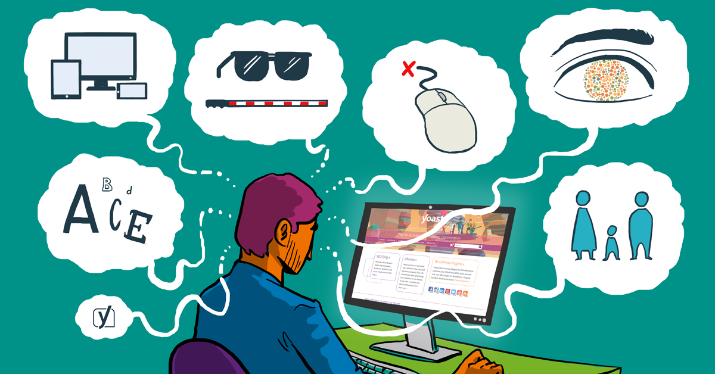
A11y
DH Topics – Fall 2017 Presented by Álvaro
Notes:
Image Source: https://cdn.yoast.com/app/uploads/2015/11/Accessibility_matters_FI-1.png

Slide 2
Confused?
ACCESSIBILITY
There are 11 letters between the “A” and the “Y”
A11Y
Notes:
The funny irony here is that this treatment of the word accessibility is in itself not immediately accessible. But perhaps there’s a lesson in there, and that’s the point.

Slide 3
What is accessibility?
Could it be as simple as saying, it’s the ability to access, and everything that entails?
Notes:
So, what is accessibility?
Could it be as simple as saying, it’s the ability to access, and everything that entails?

Slide 4
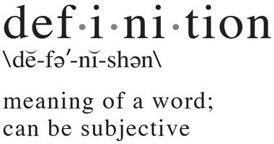
Definitions are popular, so let’s have a go.
Let’s try defining it in these contexts:
General terms
Define it
What does it include? Not include?
Digital terms
Define it
What does it include? Not include?
Notes:
Image Source: https://www.researchgate.net/post/How_to_define_Definition
Well, let’s start kicking around some definitions.
In the interest of time, let’s look at accessibility in general terms and then in digital terms, as we try to define it, and discuss what it includes, and what it may not include.

Slide 5
Notes:
From: https://www.slideshare.net/srains/developing-an-accessible-tourism-strategy-disabled-travelers-guide-to-the-galaxy
Types of impairments that exist on a spectrum running from passive to extreme, with low to high levels of support from a variety of assistive technologies:
Mobility
Vision
Hearing
Speech
Mental
Hidden
Ageing
From ACCESS article:
Accessibility exists when a user (who may or may not have a particular disability) can easily make use of a particular digital resource (which may be textual, auditory, visual, or some combination) with their choice of technology (which may or may not be explicitly labeled “assistive” technology) and can, as a result, cognitively process the information as it comes to them from that resource through that technology.
(source: https://digitalpedagogy.mla.hcommons.org/keywords/access/)

Slide 6
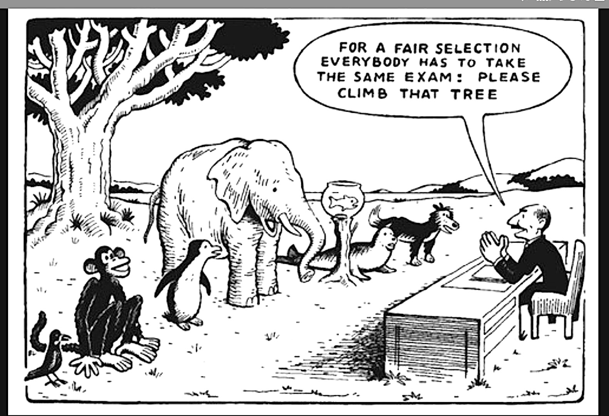
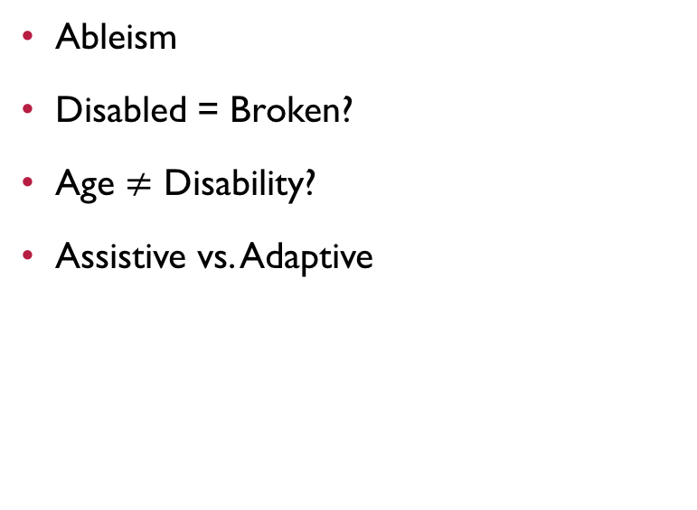
Biases and stereotypes
Ableism
Disabled = Broken?
Age $≠$ Disability?
Assistive vs. Adaptive
Notes:
As some of us read in the Bookworm Blues article, Ableism is the elephant in the room, and is “that belief that everyone who is able-bodied is “normal” and everyone else is abnormal”. In this light, we tend to put the onus on people with disabilities to adapt to the environment around them, with the few adaptations (whether successful or not) that we provide for them.
In this same context, disabled does not mean broken. More often than not, it simply means that people with certain disabilities may do things in a different way than the majority. So this begs the question, is disability defined through consensus? If enough of us experience a disability, does that become the norm, and everyone who does not have that disability is now the disabled? Think of eyeglasses.
Also, as our demographics change and baby boomers age, we will experience a kind of disability creep as more people will start to have issues with vision, motor skills, hearing, and cognition. It’s a funny kind of ableism, in which we do not tend to see this as disability; instead we label it “just getting old”. However, functionally speaking, the issues being faced are the same.
And what about assistive versus adaptive technologies? Between these two, there is a big blurry grey line, which often causes confusion. Especially since Assistive, technically includes adaptive. However, it may be helpful to think of it like this: ADAPTIVE is tech that sits on top of other tech, such as screen reader software, closed captioning, etc. It ADAPTS a technology to make it (or its content, or interactions) accessible to a wider range of people. ASSISTIVE is tech that is created to allow people to perform interactions with the abilities they already have. E.g., hearing aids, wheel chairs, eyeglasses, and ramps. So, it ASSISTS people in performing certain tasks with more independence. We tend to have a real bias towards assistive tech, especially when it’s associated with disability creep due to age.
Sources: http://www.assistivetech.com/adaptive-technology-versus-assistive-technology/ and http://www.assistivetechnology.vcu.edu/2008/08/29/whats-the-difference-between-a/

Slide 7
A realization
“
When we compartmentalize accessibility, we allow ourselves to prioritize its execution in certain contexts over others, which means that we are not creating a consistent life experience for anyone. If we were to embrace universal design everywhere, we could start to create a consistency of experience that is more inclusive by default.
“
Notes:
So, after some research, I came to the following realization.
When we compartmentalize accessibility, we allow ourselves to prioritize its execution in certain contexts over others, which means that we are not creating a consistent life experience for anyone. If we were to embrace universal design everywhere, we could start to create a consistency of experience that is more inclusive by default.

Slide 8
Where does A11y impact?
Notes:
With that in mind, we begin to think about where accessibility impacts the human experience.
What follows is by no means an exhaustive list, but it is one that I felt was representative of what we are talking about in this course.

Slide 9
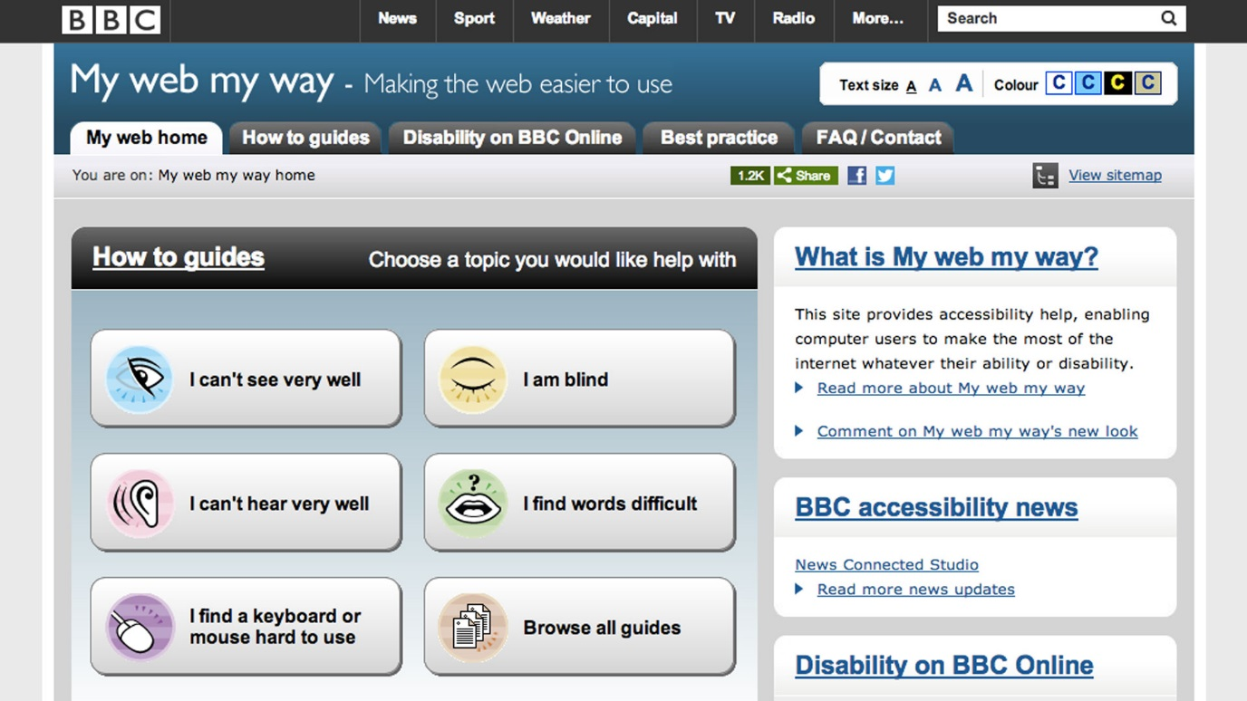
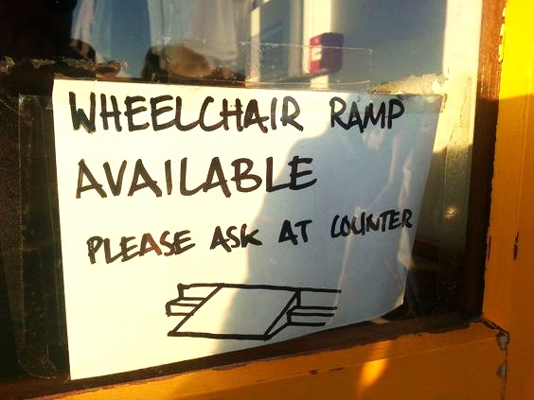
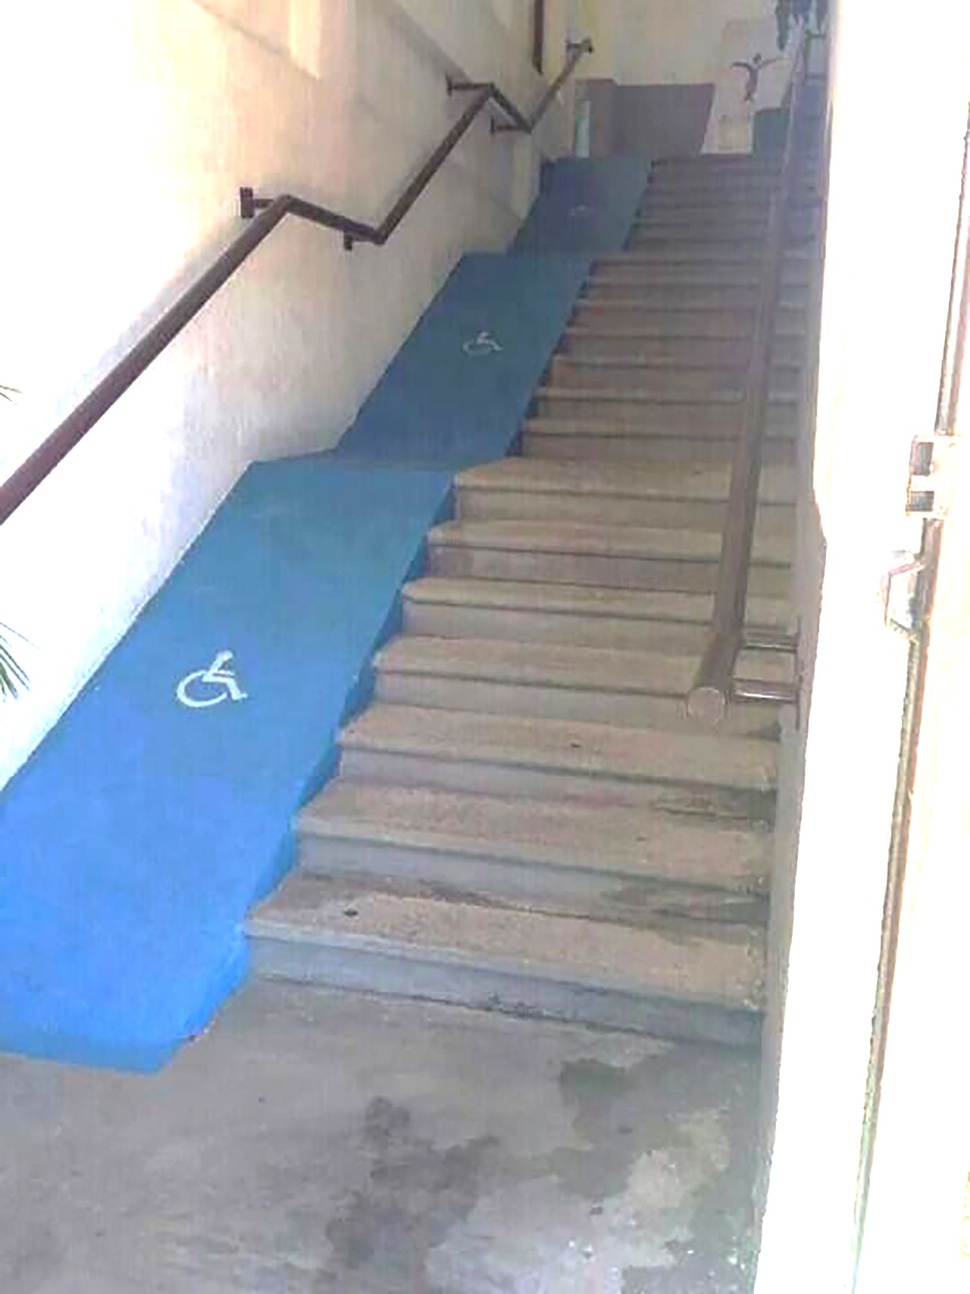

Public spaces
Assumptions about access
Accessibility = Retrofit
Government online is a kind of public space
Online Shopping
Notes:
In public spaces we continually make assumptions about access, and that is likely because we take so much of our own experience for granted. E.g., you may assume that a person with a disability would not be alone.
When we talk about the notion of accessibility, it is often in the context of making something accessible after the fact, which means that we may make assumptions about use that are difficult to understand unless you experience them yourself. In retrofitting an existing design, we are somewhat bound by the constraints that the design provides, which means that decisions about accessibility will be biased towards the design it sits on top of, and not necessarily its actual usability.
Which leads us to online. So much of our government’s service and program delivery happens online nowadays that sites such as Canada.ca could almost be considered public spaces online. Without appropriate access for people with different requirements, we could be preventing people with disabilities from accessing programs and services that they are entitled to, with the same level of convenience as ”able” people. In 2012, the Jodhan case made sure that any public-facing GC site would become accessible. However, due to low funding and resources, the GC managed to meet the minimum requirements for accessibility. This means that in certain cases, a person with a screen reader would have to click a down arrow 126 times to get to the content they want. We are just now starting to move towards more universal design, with a goal of creating meaningful experiences for everyone.
Online shopping sites , such as amazon, could also be considered a kind of public online space. But, what if you are a person that suffers from dyslexia? You may find it difficult to shop, if the typography is not flexible or if the language is written in less-accessible ways.
Jodhan Case Source: (http://www.ccdonline.ca/en/blog/jodhan)

Slide 10
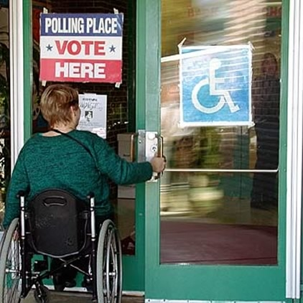
Citizen Engagement
Democracy via voting
Participation in public activities
Employment
Digital engagement with government
Notes:
Image Source: http://www.accesscomplianceservices.net/mediafiles/subpages/images/md_12_polling.jpg
Although there have been laws around for some time regarding accessibility for certain things such as voting, it does not necessarily mean that accessibility will be properly implemented. Also, in a very western-centric sense, we assume that if we make enough of a fuss, things will be made to change. However, when considering less-developed nations, whose views on disability may be less inclusive, people with certain disabilities may be excluded from the democratic process altogether.
Public activities such as demonstrations are another way in which people with disabilities may be disengaged. Having said that, given how some demonstrations can turn ugly quickly, it may not be the best example. However, in this case, how does the disabled citizen’s discontent get communicated?
Employment? In a 2012 study by StatsCan, the unemployment rate amongst people with disabilities was double of those without (~11% vs ~6%). The ability to participate in the economy through employment is a form of citizen engagement, in that it allows one to contribute to the creation of knowledge and wealth for a country. Poor access to employment may disengage citizens from participating in other socio-economic activities, and also make them feel like they do not have a right to a voice.
All of this trickles down eventually to digital engagement with government. Say I have limited education but really want to be able to submit my own taxes online. Use of complex versus plain language may prevent me from doing that. Or as an aged person with low visibility, a tremor, and little support, I may have trouble accessing information on my benefits.

Slide 11
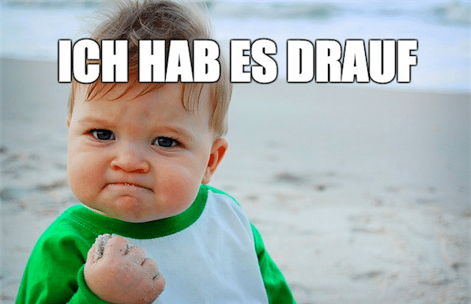
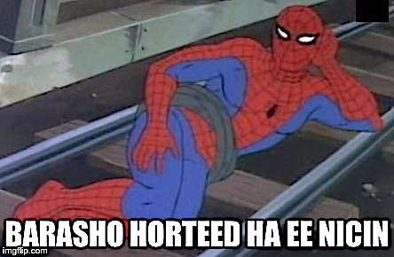



Social Participation
Notes:
Image source (yoda): https://i.pinimg.com/736x/b3/26/9e/b3269e880f762ba7e828b5faf7ed0630--a-meme-funny-memes.jpg
The ability to participate in different social activities online could be hampered by something as simple as which language you understand. We probably all recognize the images in the backgrounds of these memes, but not necessarily the meaning of the words.
GERMAN – I’ve got this!
POLISH – The farther your gym clothes are, the more tired you feel
SOMALI - Get to know me, before you reject me
As humans we are social beings, and not having access to localized social networks (geographically speaking) through online platforms, could have an adverse effect on people, which could become an adverse effect on society.
Also, as an interesting aside, translation platforms such as google translate are continually evolving their dictionaries based on algorithms that are programmed by people. So, who controls what we read or say in another language? If the translations are based on consensus, are they necessarily correct? How could this affect things like policy interpretation or rules for small business and/or individuals? Could it be an appropriate defense for wrong-doing?

Slide 12
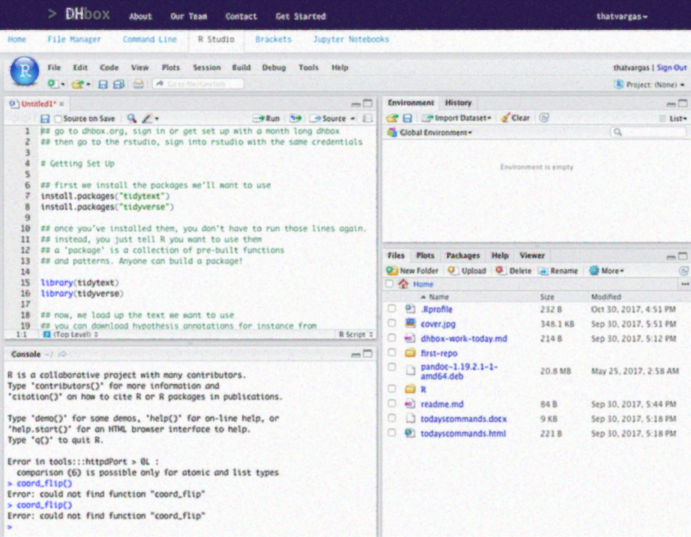
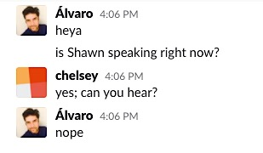
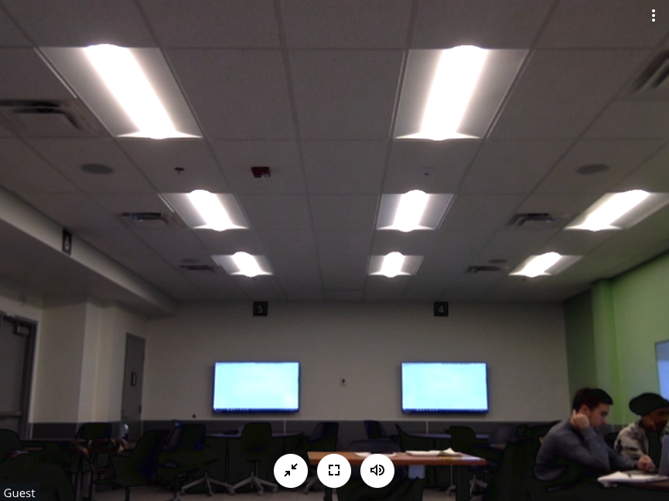
A11y can be contextual
Notes:
Accessibility can also be contextual.
A couple of weeks ago I had hurt my back so opted to stay home; a low-level temporary disability.
This was my experience with accessing our class from home. Due to the infrastructure constraints of the room, the experience with attending class virtually was less than ideal.
So, accessibility can be contextual. Whether in public spaces or online, if the underlying infrastructure has not been fully and meaningfully thought through, it can create barriers to accessibility.

Slide 13
Oh, and One more thing…

Slide 14
“You Can’t Think About Thinking Without Thinking About Thinking About Something.”
– Seymour Papert
Umm, what?!

Slide 15
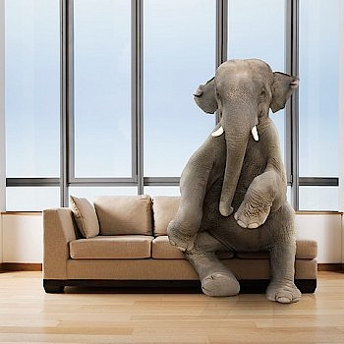
plain language (especially in academia) – Can we talk?
Academic writing is not always accessible
Construction of identities and credibility
Assimilation and Accommodation
What’s the deal, Shawn? Everyone?
Notes:
Image source: http://www.powerretail.com.au/wp-content/uploads/2014/12/elephant.jpg
Plain language is the elephant in the room. Academic writing is known for being thick, which means that not everyone can just pick up and read it. Some literature is like that as well.
Is this part of some social construction of identities for which we feel we need certain professions to seem less accessible to establish their credibility? Is it perhaps because in academia we are often dealing with things at more theoretical levels, and as a result we want people to enter the discourse only when they have enough of a context to be able to contribute to the production of knowledge, rather than distract from it with noise?
Part of Jean Piaget’s theory of cognitive development speaks to the notions of Assimilation and Accommodation, in which, especially in children, they learn a concept first by taking it in and assimilating it into their own mental models, and then later, after much interaction with the concept, they will change their mental models to accommodate new knowledge into existing knowledge.
Perhaps academic writing wants us to be somewhere between the two to begin with.
I pick on Shawn, only because he is the only Ph.D. in the room. However, I think we can all contribute to this discussion.
What do you think?

Slide 16
Plain Language - Coming back to Papert
Example 1
Example 2
Draw a circle by the instructions “forward a tiny bit (in calculus language fd dx) right turn a tiny bit (rt d?) and repeat (integrate.)”
Make a turtle seek a distant light by “ if to the left rt d?, if to the right ltd A, fd dx, repeat.”
Notes:
Coming back to Seymour Papert and his paper titled, ““You Can’t Think About Thinking Without Thinking About Thinking About Something.”, in it, he gave two examples of how to teach calculus to children.
Example one is more along the lines of Assimilation, while example 2 is more along the lines of Accommodation. I.e. One is more accessible than 2 because it does not presuppose that you have internalized the concepts of calculus.
When we talk about plain language then, it is perhaps best to think of it in terms of writing for assimilation, and not assuming that everyone will willing to accommodate you as the writer.
In a context of policy, rules, and regulations, the easier it is to comprehend these frameworks by people, the more likely it is that they will be able to remain compliant with them. As we say in UX, make the right thing to do, the easiest thing to do.

Slide 17
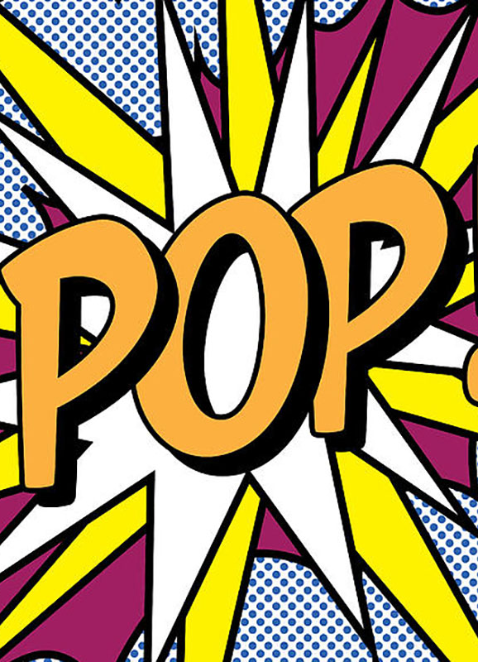
Activity
LET’S TRY ONE.
Notes:
Image Source: https://d2jv9003bew7ag.cloudfront.net/uploads/What-Is-Pop-Art.jpg

Slide 18
Plain language
“Simplify,
Simplify.”
– Thoreau
Tips:
No Jargon
Use active voice
Use everyday words
Shorter sentences
Words with less syllables
Notes:
Image Source: https://d2jv9003bew7ag.cloudfront.net/uploads/What-Is-Pop-Art.jpg
Tips source: https://zapier.com/blog/plain-language/
Please take your handouts, and work in groups of three.
No Jargon – use more universal language, not things that may only be understood by a subset of people in certain knowledge domains
Use active voice – so, the subject performs the action. E.g., I jumped vs. A jump was made by me.
Use everyday words
Shorter sentences – Get to the point quicker.
Words with less syllables
How was that? What were some of the difficulties you faced in this exercise?

Slide 19
A11y and compliance online
Notes:
So now let’s look at accessibility and compliance online.

Slide 20
Lenses of compliance for A11y
Laws
Rules and Regulations
Policies and Standards
Governance
Transparency
Requirements
The planets rarely align, so it is largely a “get as many of them to align as you can and build out from there” type of scenario.
FULL COMPLIANCE
Notes:
These are the typical elements that go into compliance for the web and interactive applications. If you look at them as a set of lenses, you can see how their intersections can create their own subsets of complexity and discourse. Sadly, the planets rarely align to get full compliance. And so we end up with trying to get as many of them to align, and then implement (usually as some kind of retrofit) and iterate with improvements over time.
However, this is starting to change, as we are becoming more aware of the benefits of universal design, and the concept of inclusive by design and accessible by default.
It also raises the question of whether design is a human right, or a nice add-on.
Rules = instructions for way things SHOULD be done – can be more organic and flexible
Regulations = rules enforceable by law – more rigid
Standards= Quantifiable low-level controls for level of quality expected. Think quantifiable metrics.
Policies = high-level enforceable rules and guidelines at an organizational level. Think scope and issue identification.

Slide 21
CURRENT STANDARDS CENTRAL TO WEB A11y
World Wide Web Consortium (W3C)
(HTML5, CSS, SVG, MathML)
Web Accessibility Initiative (WAI)
(Web content accessibility guidelines (WCAG) + Accessible Rich Internet Applications (ARIA))
International Digital Publishing Forum (IDPF)
(ePub)
Notes:
Source: https://www.slideshare.net/BaltimoreNISO/lapierre-impact-on-the-user-accessibility
Currently, these are the standards at the heart of accessibility on the web and in the digital realm.
The world wide web consortium provides much guidance for the underlying infrastructure of the internet with code, as well as implementation of content and interactions online.
The International Digital Publishing Forum provides guidance on ePub, which is largely touted as an intrinsically accessible format for content.
Having said that, what they provide is guidance. It is up to the developers and creators of sites, applications, and content to make sure that they are not only compliant with minimum requirements as stated by various legislature, but are also designing more meaningful experiences for all.

Slide 22
WCAG’S 4 PRINCIPLES OF A11y
UNDERSTANDABLE
OPERABLE
ROBUST
PERCEIVABLE
Notes:
Source: https://www.w3.org/TR/UNDERSTANDING-WCAG20/intro.html
The Web Content Accessibility Guidelines’ state 4 principles, that anyone who wants to use the Web must have access to content that is: perceivable, operable, understandable, and robust.
Perceivable - Information and user interface components must be presentable to users in ways that enable them to perceive the information being presented, and it can't be invisible to all of their senses
Operable - the interface cannot require interaction that a user cannot perform
Understandable - the content or operation of the user interface cannot be beyond the understanding of users. I.e., they must be able to understand the information as well as the operation of the user interface
Robust - Content must be robust enough that it can be interpreted reliably by a wide variety of user agents, including assistive technologies.
So, as technologies and user agents evolve, the content should remain accessible
If any of these are not true, users with disabilities will not be able to use the Web.

Slide 23
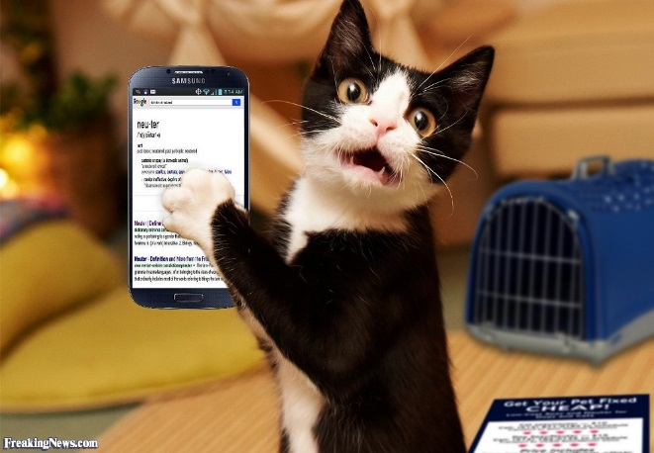
Case Study – A11y challenges for mobile devices and those with disabilities
Perceivable
Improper use of colour
Media not captioned and/or with no ALT
Sense-bias on content (visual, auditory)
Operable
No coherent structure to content
Special scripting and/or plug-ins required to use/interact with content
Pointing device required for interaction with content
Understandable
Non-plain language
Intent of interactions is unclear
Attention thieves
Robust
Non-system agnostic
Notes:
Source: https://www.w3.org/WAI/mobile/experiences
Image source: http://www.freakingnews.com/pictures/118000/Cat-Using-Google-on-a-Cell-Phone-118007.jpg
A case study. It is interesting to think that ”able” people on phones and ”disabled” people on the web, in general, can suffer similar challenges in the use of content on the web.
Perceivable
Improper use of colour – problematic for people with colour blindness, low visibility, or using accessibility settings such as colour inversion or grayscale.
Media not captioned and/or with no ALT data – Problematic for blind and deaf people, colour blind (if content is colour dependent), and people with cognitive issues.
Sense-bias on content (visual, auditory) – problematic for people with a disability that content is not favoured for.
Operable
No coherent structure to content – Cognitively difficult to understand the flow of content, difficult for certain assistive devices to help a user understand the content because of a lack of semantic structure. i.e., the relationship between content elements, in the context of the overall narrative.
Special scripting and/or plug-ins required to use/interact with content – Could make content non-accessible in environments where scripting is not compatible with system/applications (not necessarily disabled people either).
Mouse or other pointing device required for interaction with content – Could make content non-accessible depending on the device or the context of use.
Understandable
Non-plain language – difficult for people with cognitive issues, different education levels, and people new to a culture/context/language
Intent of interactions is unclear – windows pop up and/or close unnecessarily or without warning
Attention thieves – distracting features that make it difficult to concentrate on the content
Robust
Non-system agnostic – problematic if markup is not supported across systems and/or if scripting is required to provide access to content.

Slide 24
Activity
LET’S TRY ANOTHER.
Notes:
Image Source: https://d2jv9003bew7ag.cloudfront.net/uploads/What-Is-Pop-Art.jpg

Slide 25
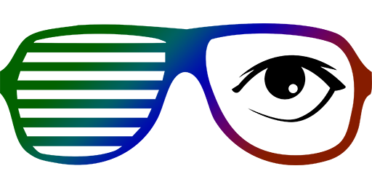
Funkify
GO TO FUNKIFY.ORG
CLICK TO INSTALL THE CHROME PLUG-IN
ONCE IT’S INSTALLED, GO TO OTTAWA.CA, CLICK ON THE FUNKIFY ICON AND SELECT “ELDERLY ELLEN”.
TRY TO FIND OUT THE DETAILS FOR GARBAGE PICK UP WHERE YOU LIVE FOR THIS WEEK.
TRY FINDING DIFFERENT SERVICES WITH THE DIFFERENT FUNKIFY PROFILES.

Slide 26
So, how do we begin to address the issue of A11y ?

Slide 27
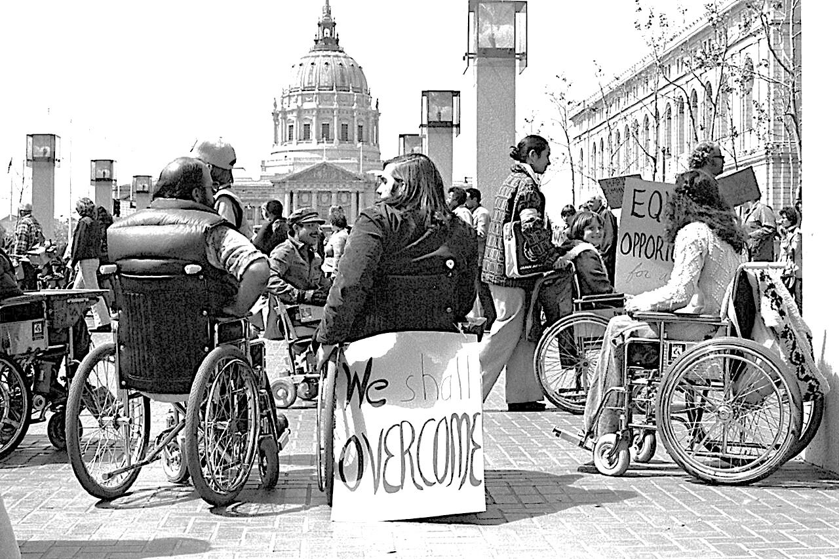
Social constructions of disability
“Othering”
Content vs. container
From disabled to diff-abled
Not every situation is appropriate for every person.
Notes:
Image source: http://www.globaldisabilityrightsnow.org/sites/default/files/images/325/504.jpg
When we look at someone with a disability we may immediately start to think about all the things that they probably can’t do. Which means that we are looking at their abilities based on our assumptions of the totality of their capabilities from looking at their bodies (or containers). This is essentially “othering”, in which we are looking at someone as being intrinsically different from ourselves, even if they are not.
But if we flip the script, and start looking at it from the perspective of the capabilities to contribute from INSIDE the person, then we are really looking at the CONTENT inside the container, which from a socio-cultural perspective, is where the value lies, in a person’s ability to contribute to the creation of knowledge and the sharing of it, into the human experience. Look at Stephen Hawking for example. If you were to see a person like him in a mall, you would probably start to make all kinds of assumptions about him because of his container. Meanwhile, on the inside, there is literally a universe of thinking going on.
We are all familiar with workarounds as a way of adapting ourselves or something in our environments to us achieve an objective. The idea of differently-abled means that there are some of us that do things in different ways, sometimes temporarily, sometimes permanently. By embracing the idea of diff-abled, we can start to de-fable our social constructs of disability.
I also wonder if trying to make everything accessible creates resentment towards people with accessibility requirements. The reality is that even with universal design, not every situation will be appropriate to everyone. A blind person should probably not be a pilot, but a sighted person is likely not the best candidate to be a waiter in a restaurant in which you eat in the dark. So, as we construct identities of differently-abled people, we should consider appropriateness as well, in the context of what is presently possible.

Slide 28
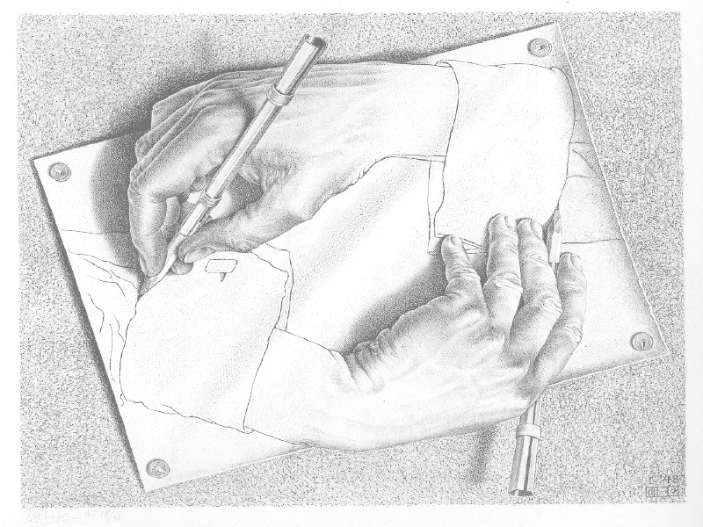
Design = Purpose + Planning + Intention
Notes:
With an awareness of how we perceive disability and accessibility through social construction, the next step in addressing issues with accessibility is design.
I would say that it’s in how we design, but design writ large, design as in the approach we take towards problem solving.
If we define design, as the purpose, planning and intention behind bringing a product or service into being, then we should look to be more inclusive by employing principles such as the ones from WCAG into every part of that process.
That way, we avoid having to retrofit inclusiveness.
As author Laura Kalbag says, “We have a tendency to build for people like us.”. This speaks to the design bias towards “able” people, in which we are continually “othering” those that are different.

Slide 29
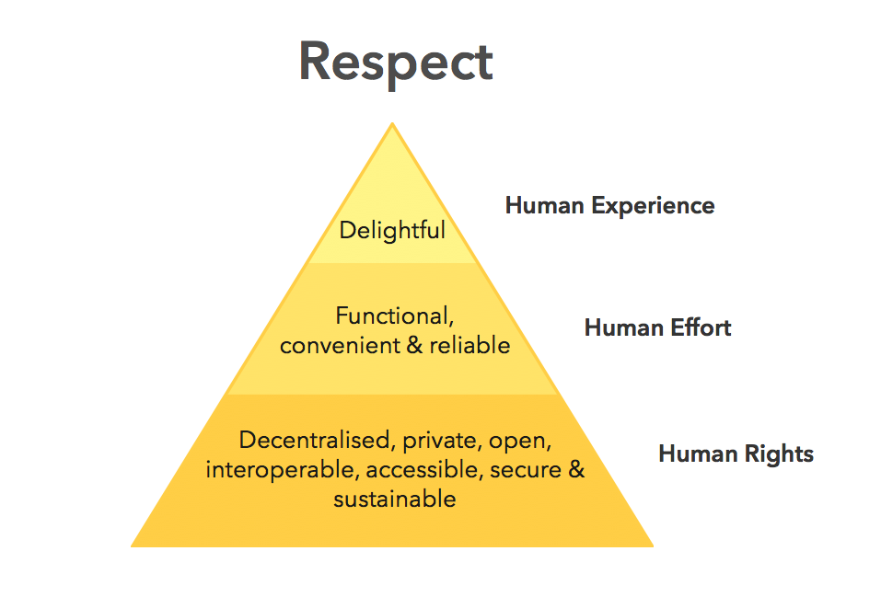
Ind.ie’s Ethical Design Manifesto
It’s about diverse groups of people coming together and designing for themselves.
When we design in this way, we have the ability to minimize the notion of the “other”, because we are doing it all together.
Ind.ie/ethical-design
Notes:
Source: https://ind.ie/ethical-design/
Ind.ie, a UK consultancy, describes themselves as a tiny two-person-and-one-husky social enterprise striving for social justice in the digital age. The two principals are Aral Balkan and Laura Kalbag. Laura recently published “Accessibility for Everyone”, which makes designing for accessibility, well, more accessible for anyone designing things in the digital realm. I posted my sketch notes from a talk she gave on her book, recently on our slack channel.
So, Ind.ie came up with a digital manifesto for design that looks something like this.
It’s about diverse groups of people coming together and designing for themselves. When we design in this way, we have the ability to minimize the notion of the “other”, because we are doing it all together.
But this is perhaps best explained by Aral Balkan himself.

Slide 30
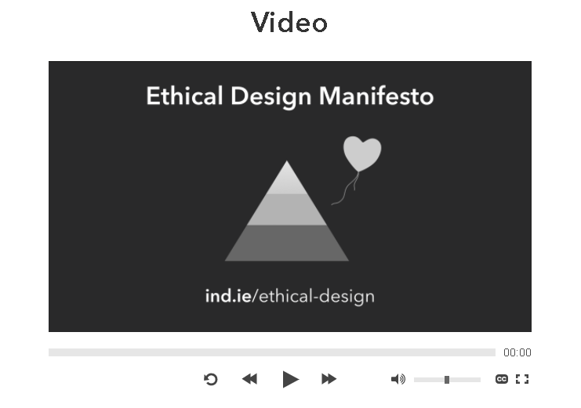
Notes:
Video Source: https://vimeo.com/158879739
Talk by Aral Balkan, Co-Founder of Indie, UK.

Slide 31
wrapping up
“
If we want realistic stories we need diverse stories.
– Kirsten Bussiere
“
This is a BIG topic
Impact on digital is not always direct
It’s about the human experience
Universal design by universal designers
Notes:
Accessibility is a really big topic, and as a result, difficult to define definitively. Having said that, in this class, I think we’re finding that a lot of these topics are.
The impact on digital sometimes comes about indirectly. In the examples of public spaces, citizen engagement, and even academia, we saw how obstacles to accessibility in the analogue can have impacts on the digital.
But at the end of the day, it’s about the human experience, which is not always easily compartmentalized into analogue or digital, especially in a world that is increasingly dependent on technology to communicate and transact.
So it seems that we would all be better off to embrace universal design, but not as outsiders to it. Instead, we need to come together as universal designers and embrace diversity in the ideation, iteration, and execution of the design of products, content, and services. This also includes iteration through continuous improvement.
For us in academia, this also applies to the creation of knowledge.
Life is real, not theoretical. So, if we want to get at solutions that are more realistic, we need to, as Kirsten suggested, embrace this diversity and start answering some of these questions from a more holistic position of knowledge.
With diversity, we can start to define problems more fully, which means that we can start addressing them more fully as well. When we work like this, there is no other, there is only us.

Slide 32
Parting Food for thought
“
What if the first question we asked was, “What is so unique about this situation that it justifies exclusion?” instead of, “How much does it cost to make it accessible?”
-- Dr. Scott Rains, Social Change Agent
“
Thank you.
Notes:
In his article “Accessibility is NOT Inclusion” Dr. Scott Rains (a known advocate for disabled people) he writes that “Accessibility is doing for — a 20thcentury task. Inclusion is doing with — a 21st-century vision.”
In this light, What if the first question we asked was, “What is so unique about this situation that it justifies exclusion?” instead of, “How much does it cost to make it accessible?”
Thank you.

Slide 33
Some Cool Tools
http://www.colorzilla.com/
https://webaim.org/articles/tools/ - Good overview of evaluation tools
http://www.funkify.org/ - Disability simulator plug-in for Chrome
https://www.citizenadvocacy.org/job-opportunities/ - local support group
Accessibility U
https://www.washington.edu/accesscomputing/AU/before.html
https://www.washington.edu/accesscomputing/AU/after.html

